Slide 1

FORAGE VIRTUAL INTERNSHIP
data visualization insights

Slide 2
INTRODUCTION:
Good Evening to all, Iam Pravallika. Iam here to share my insights for the company sales performance for the year of 2011.
I am grateful to the TATA Group for providing me with a chance to gain insightful information from the data of store performance.
Thank you to the CEO and CMO for the questions they asked me and for providing direction for the insights of the data .

Slide 3
Process:
I assure you that I took all the necessary steps to ensure that this analysis is accurate and correct.
Steps:
I collected the dataset which is you provided.
I cleaned up the data by removing all the negative values in the unitprice and quantity column.
I filtered the data as required for all the visualizations.

Slide 4
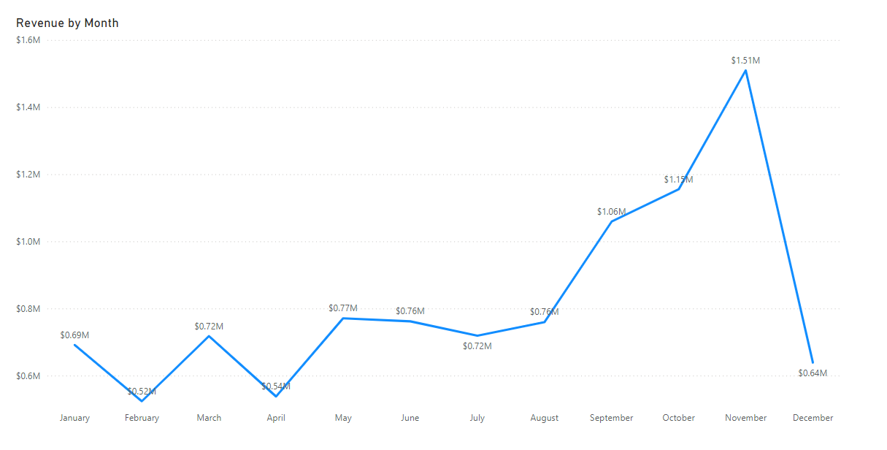
1st Query
From the above we observe that first 8 months had stable monthly revenue with an average 685k.
From the August month to December month we can observe how revenue trend seasonally affects the retail store sales.

Slide 5
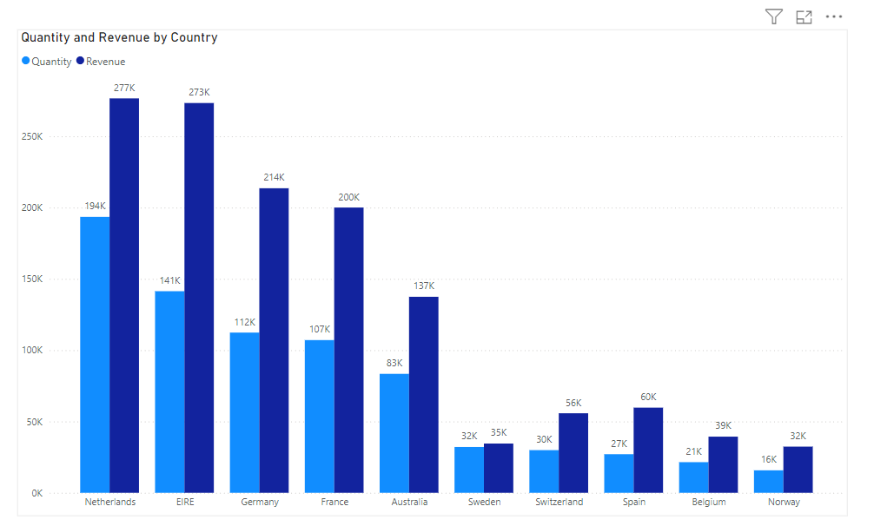
2nd quERY
This chart shows the top 10 countries of both revenue and the Quantities bought in these countries except united states.
There is no major difference between the revenue and the quantity of goods sold in these countries ,this showing a high purchasing power in these countries.

Slide 6
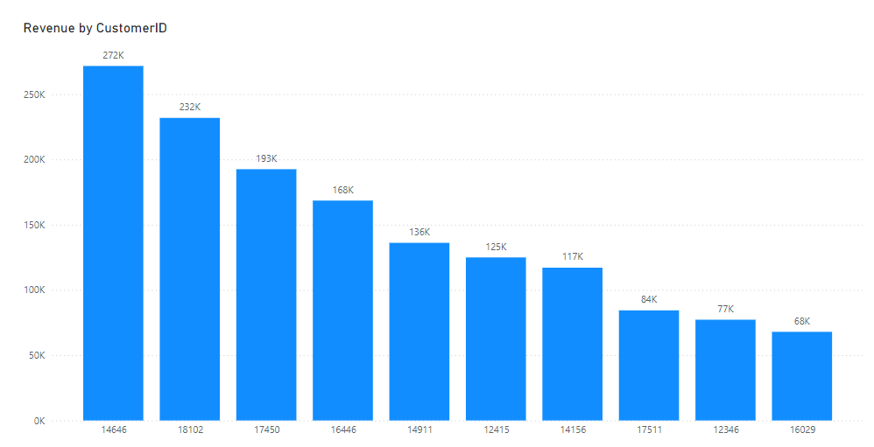
3rd Query
This chart describes about the average difference between the top 10 countries.
The company can aim to strengthen the relationships with these customers to increase. customer loyality and retention and ultimately drive more sales and revenue for the company.

Slide 7
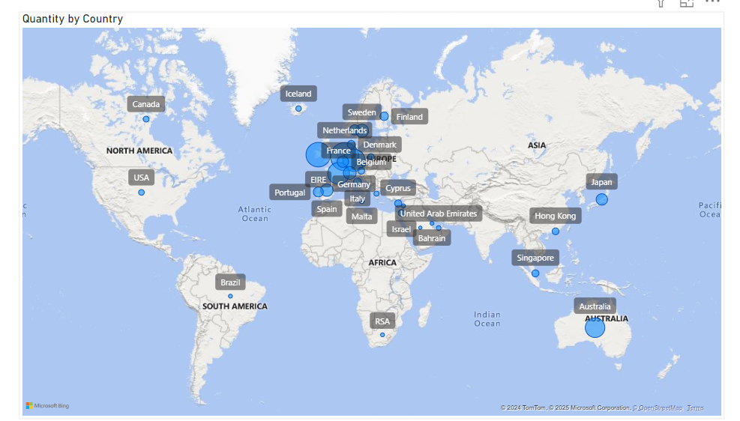
4th query
The above map chart concludes that by comparing the places that have produced the greatest revenue to those that have not.
There is no market in Africa,Asia,Russaia.
The map shows that the majority of sales in occur only in European market more and dive deeper into these region to maximize sales

Slide 8
RECOMMENDATIONS:
The company should use more technologies and strategies to attract new customers in a creative way that aims at stocking.
The company should create a relationship between customers those who ordered in big quantities.
As we observed European market has more demand so, the company must catch the market and grow the sales.
Balancing both new and regular customers in a strategical way show the results which is the growth of the sales and the company

